Slide 1

Heap & Heap Sort Algorithm
2CS503 Design & Analysis of Algorithm

Slide 2
Introduction
A heap data structure is a binary tree with the following two properties.
It is a complete binary tree: Each level of the tree is completely filled, except possibly the bottom level. At this level it is filled from left to right.
It satisfies the heap order property: the data item stored in each node is greater than or equal to the data item stored in its children node.
a
a
9
9
b
c
b
c
6
7
6
7
d
e
f
d
e
f
2
4
8
2
4
1
Binary Tree but not a Heap
Complete Binary Tree - Heap
Not a Heap
Heap

Slide 3
Array Representation of Heap
Heap can be implemented using an Array.
An array 𝐴 that represents a heap is an object with two attributes:
𝑙𝑒𝑛𝑔𝑡ℎ[𝐴], which is the number of elements in the array, and
ℎ𝑒𝑎𝑝−𝑠𝑖𝑧𝑒[𝐴], the number of elements in the heap stored within array 𝐴
16
14
10
8
7
9
3
Array representation of heap
2
4
1
16
14
10
8
7
9
3
2
4
1
Heap

Slide 4

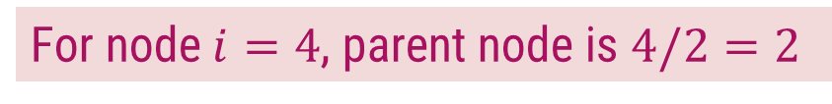









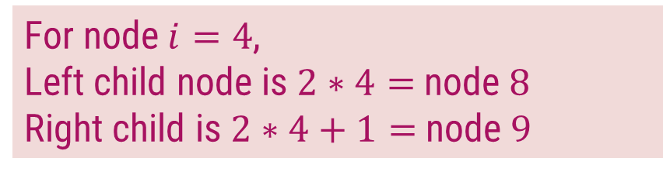
Array Representation of Heap
In the array 𝐴, that represents a heap
length[𝐴] = heap-size[𝐴]
For any node 𝒊 the parent node is 𝒊/𝟐
For any node 𝒊, its left child is 𝟐𝒊 and right child is 𝟐𝒊 +𝟏
For node $i=4$, parent node is $4/2=2$
$$1$$
16
For node $i=4$,
Left child node is $2∗4=$node $8$
Right child is $2∗4+1=$node $9$
$$2$$
$$3$$
14
10
$$4$$
$$5$$
$$6$$
$$7$$
8
7
9
3
$$1$$ | $$2$$ | $$3$$ | $$4$$ | $$5$$ | $$6$$ | $$7$$ | $$8$$ | $$9$$ | $$10$$
$$8$$
$$9$$
$$10$$
14
8
2
4
2
4
1
16
14
10
8
7
9
3
2
4
1
Heap

Slide 5
Types of Heap
Max-Heap − Where the value of the root node is greater than or equal to either of its children.
9
6
7
2
4
1
1
Min-Heap − Where the value of the root node is less than or equal to either of its children.
2
4
6
7
9

Slide 6
Introduction to Heap Sort
Build the complete binary tree using given elements.
Create Max-heap to sort in ascending order.
Once the heap is created, swap the last node with the root node and delete the last node from the heap.
Repeat step 2 and 3 until the heap is empty.

Slide 7

Heap Sort – Example 1
Sort the following elements in Ascending order
4 | 10 | 3 | 5 | 1
Step 1 : Create Complete Binary Tree
4
$$1$$ | $$2$$ | $$3$$ | $$4$$ | $$5$$
4 | 10 | 3 | 5 | 1
10
3
Now, a binary tree is created and we have to convert it into a Heap.
5
1

Slide 8
Heap Sort – Example 1
Sort the following elements in Ascending order
4 | 10 | 3 | 5 | 1
Step 2 : Create Max Heap
4
10
10 is greater than 4
So, swap 10 & 4
$$1$$ | $$2$$ | $$3$$ | $$4$$ | $$5$$
4 | 10 | 3 | 5 | 1
10
4
10
3
4
Swap
In a Max Heap, parent node is always greater than or equal to the child nodes.
5
1

Slide 9
Heap Sort – Example 1
Sort the following elements in Ascending order
4 | 10 | 3 | 5 | 1
Step 2 : Create Max Heap
10
5 is greater than 4
So, swap 5 & 4
$$1$$ | $$2$$ | $$3$$ | $$4$$ | $$5$$
10 | 4 | 3 | 5 | 1
5
4
4
3
5
Swap
In a Max Heap, parent node is always greater than or equal to the child nodes.
5
1
4
Max Heap is created

Slide 10
Heap Sort – Example 1
Sort the following elements in Ascending order
4 | 10 | 3 | 5 | 1
Step 3 : Apply Heap Sort
10
1
$$1$$ | $$2$$ | $$3$$ | $$4$$ | $$5$$
10 | 5 | 3 | 4 | 1
1
10
5
3
Swap
Swap the first and the last nodes and
Delete the last node.
4
1
10

Slide 11
Heap Sort – Example 1
Sort the following elements in Ascending order
4 | 10 | 3 | 5 | 1
Step 3 : Apply Heap Sort
1
5
Max Heap Property is violated so, create a Max Heap again.
$$1$$ | $$2$$ | $$3$$ | $$4$$ | $$5$$
1 | 5 | 3 | 4 | 10
5
1
1
4
5
3
1
4
Swap
4
1

Slide 12
Heap Sort – Example 1
Sort the following elements in Ascending order
4 | 10 | 3 | 5 | 1
Step 3 : Apply Heap Sort
5
1
Max Heap is created
$$1$$ | $$2$$ | $$3$$ | $$4$$ | $$5$$
5 | 4 | 3 | 1 | 10
1
5
4
3
Swap
Swap the first and the last nodes and
Delete the last node.
1
5

Slide 13
Heap Sort – Example 1
Sort the following elements in Ascending order
4 | 10 | 3 | 5 | 1
Step 3 : Apply Heap Sort
1
Create Max Heap again
3
4
$$1$$ | $$2$$ | $$3$$ | $$4$$ | $$5$$
1 | 4 | 3 | 5 | 10
4
1
4
3
Max Heap is created
4
3
1
4
Swap
Swap the first and the last nodes and
Delete the last node.

Slide 14
Heap Sort – Example 1
Sort the following elements in Ascending order
4 | 10 | 3 | 5 | 1
Step 3 : Apply Heap Sort
3
Already a Max Heap
1
$$1$$ | $$2$$ | $$3$$ | $$4$$ | $$5$$
3 | 1 | 4 | 5 | 10
1
3
1
3
Swap
Swap the first and the last nodes and
Delete the last node.

Slide 15
Heap Sort – Example 1
Sort the following elements in Ascending order
4 | 10 | 3 | 5 | 1
Step 3 : Apply Heap Sort
1
Already a Max Heap
$$1$$ | $$2$$ | $$3$$ | $$4$$ | $$5$$
1 | 3 | 4 | 5 | 10
1
Remove the last element from heap and the sorting is over.

Slide 16
Heap Sort – Example 2
Sort given element in ascending order using heap sort. 19, 7, 16, 1, 14, 17
19 | 7 | 16 | 1 | 14 | 17
14
17
7
16
Step 1: Create binary tree
Step 2: Create Max-heap
19
19
7
16
7
16
14
17
1
14
17
1
14
17
7
16

Slide 17
Heap Sort – Example 2
Step 3
Step 4
19 | 14 | 17 | 1 | 7 | 16
16 | 14 | 17 | 1 | 7 | 19
16
19
17
16
19
16
Create Max-heap
16
17
Swap & remove the last element
14
17
14
17
16
1
7
16
1
7
19

Slide 18
Heap Sort – Example 2
Step 5
Step 6
17 | 14 | 16 | 1 | 7 | 19
7 | 14 | 16 | 1 | 17 | 19
7
17
16
7
17
7
Create Max-heap
7
16
Swap & remove the last element
14
16
14
16
7
1
7
1
17

Slide 19
Heap Sort – Example 2
Step 7
Step 8
16 | 14 | 7 | 1 | 17 | 19
1 | 14 | 7 | 16 | 17 | 19
1
16
14
1
16
1
Create Max-heap
1
14
Swap & remove the last element
14
7
14
7
1
1
16

Slide 20
Heap Sort – Example 2
Step 9
Step 10
14 | 1 | 7 | 16 | 17 | 19
7 | 1 | 14 | 16 | 17 | 19
7
14
1
7
14
7
Already a Max-heap
7
Swap & remove the last element
1
Swap & remove the last element
1
7
1
14
7
Step 11
1 | 7 | 14 | 16 | 17 | 19
1 | 7 | 14 | 16 | 17 | 19
1
Remove the last element
The entire array is sorted now.

Slide 21
Exercises
Sort the following elements using Heap Sort Method.
34, 18, 65, 32, 51, 21
20, 50, 30, 75, 90, 65, 25, 10, 40
Sort the following elements in Descending order using Hear Sort Algorithm.
65, 77, 5, 23, 32, 45, 99, 83, 69, 81

Slide 22
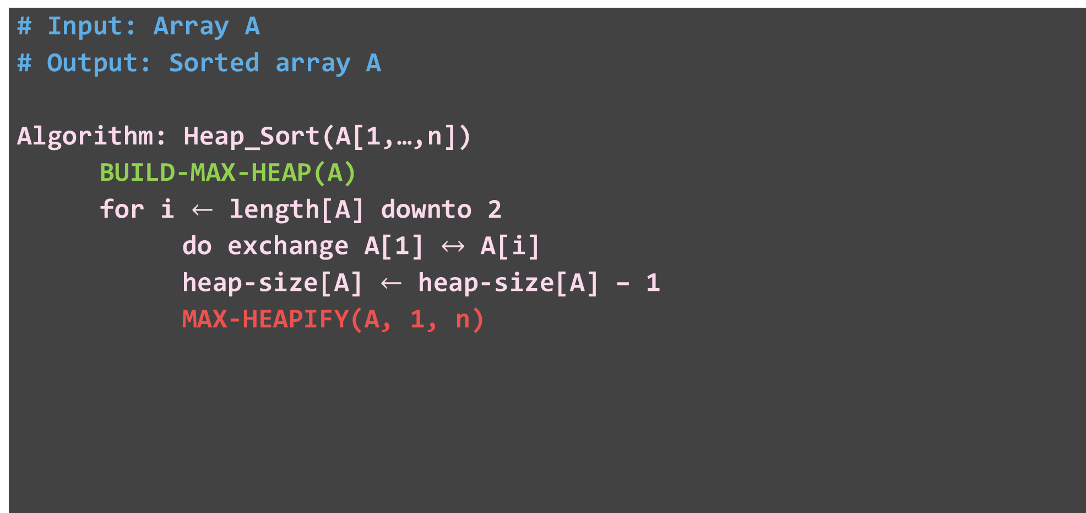
Heap Sort – Algorithm
# Input: Array A
# Output: Sorted array A
Algorithm: Heap_Sort(A[1,…,n])
BUILD-MAX-HEAP(A)
for i $←$ length[A] downto 2
do exchange A[1] $↔$ A[i]
heap-size[A] $←$ heap-size[A] – 1
MAX-HEAPIFY(A, 1, n)

Slide 23
Heap Sort – Algorithm
Algorithm: BUILD-MAX-HEAP(A)
heap-size[A] ← length[A]
for i ← ⌊length[A]/2⌋ downto 1
do MAX-HEAPIFY(A, i)
4 | 1 | 3 | 2 | 9 | 7
1
4
2
3
1
3
4
5
6
heap-size[A] = 6
2
9
7
4 | 1 | 7 | 2 | 9 | 3
4 | 9 | 7 | 2 | 1 | 3
9 | 4 | 7 | 2 | 1 | 3
i = 3
1
4
i = 2
1
i = 1
1
4
4
9
2
3
2
3
2
3
1
3
7
9
7
7
1
9
4
4
5
6
4
5
6
4
5
6
2
9
7
2
9
3
2
1
3
3
1

Slide 24
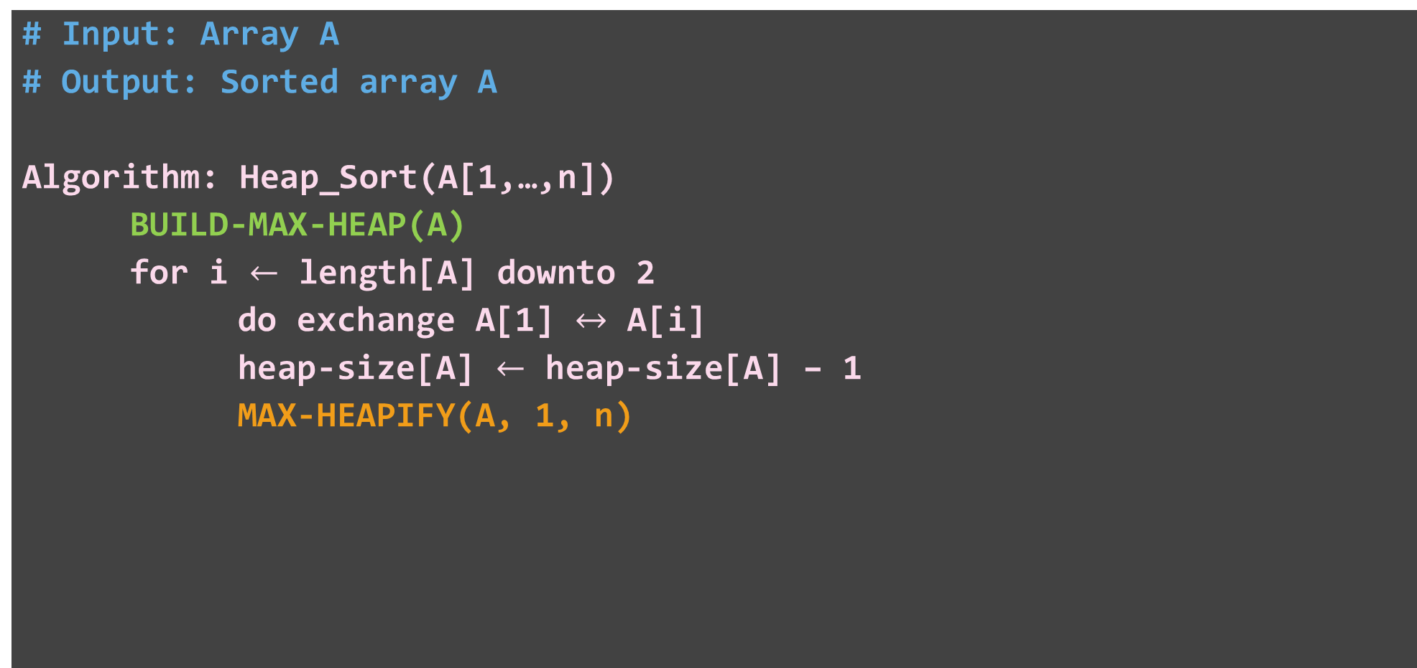
Heap Sort – Algorithm
# Input: Array A
# Output: Sorted array A
Algorithm: Heap_Sort(A[1,…,n])
BUILD-MAX-HEAP(A)
for i $←$ length[A] downto 2
do exchange A[1] $↔$ A[i]
heap-size[A] $←$ heap-size[A] – 1
MAX-HEAPIFY(A, 1, n)
3 | 4 | 7 | 2 | 1 | 9
9 | 4 | 7 | 2 | 1 | 3
1
9
2
3
4
7
4
5
6
2
1
3

Slide 25

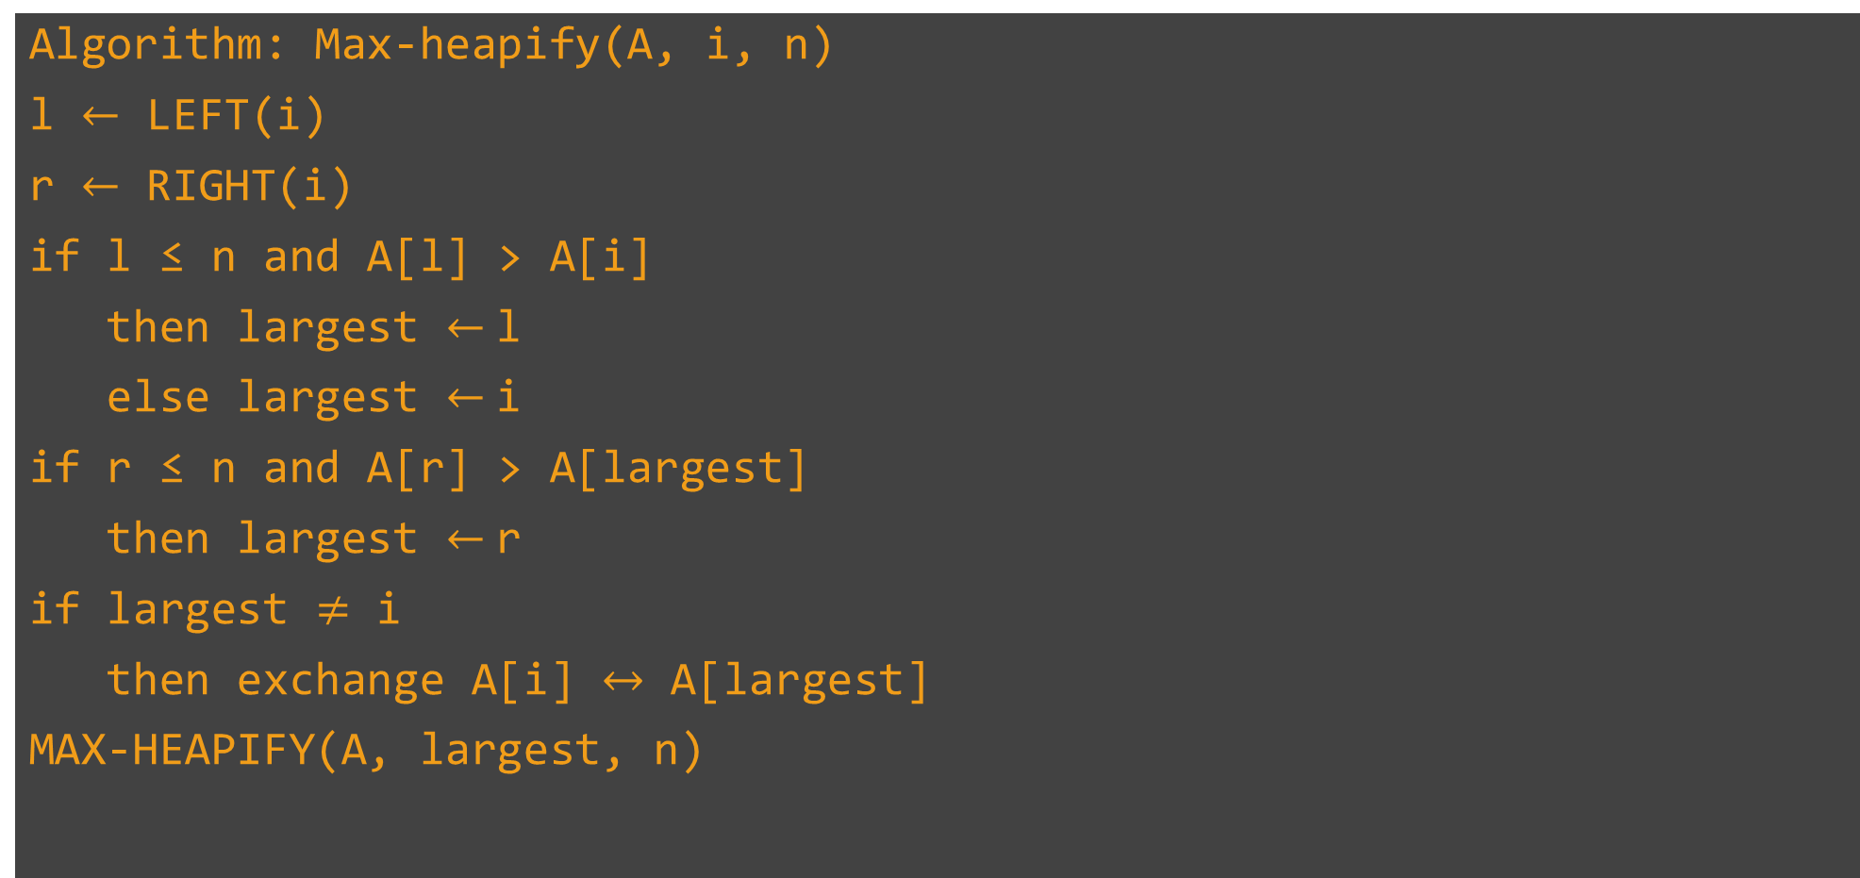



Heap Sort – Algorithm
Algorithm: Max-heapify(A, i, n)
l $←$ LEFT(i)
r $←$ RIGHT(i)
if l ≤ n and A[l] > A[i]
then largest $←$l
else largest $←$i
if r ≤ n and A[r] > A[largest]
then largest $←$r
if largest $≠$ i
then exchange A[i] $↔$ A[largest]
MAX-HEAPIFY(A, largest, n)
3 | 4 | 7 | 2 | 1 | 9
l $←$ 2
1
r $←$ 3
1
3
Yes
2
3
largest $←$ 2
4
7
4
5
Yes
2
1
largest $←$ 3
Yes

Slide 26
Heap Sort – Algorithm
# Input: Array A
# Output: Sorted array A
Algorithm: Heap_Sort(A[1,…,n])
BUILD-MAX-HEAP(A)
for i $←$ length[A] downto 2
do exchange A[1] $↔$ A[i]
heap-size[A] $←$ heap-size[A] – 1
MAX-HEAPIFY(A, 1, n)
3 | 4 | 7 | 2 | 1 | 9
1
7
2
3
4
3
4
5
2
1

Slide 27
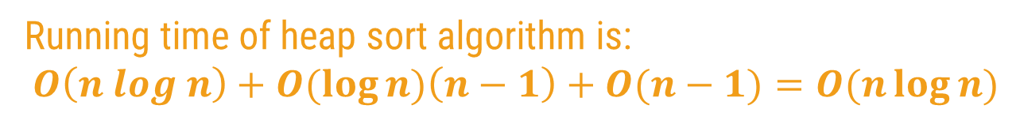



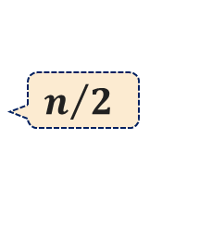

Heap Sort Algorithm – Analysis
# Input: Array A
# Output: Sorted array A
Algorithm: Heap_Sort(A[1,…,n])
BUILD-MAX-HEAP(A)
for i $←$ length[A] downto 2
do exchange A[1] $↔$ A[i]
heap-size[A] $←$ heap-size[A] – 1
MAX-HEAPIFY(A, 1, n)
heap-size[A] ← length[A]
for i ← ⌊length[A]/2⌋ downto 1
do MAX-HEAPIFY(A, i)
$$n/2$$
$$O(n log⁡n)$$
$$O( log⁡n)$$
$$n−1$$
$$O(n−1) (logn)$$
Running time of heap sort algorithm is:
$$O\left(n log n\right)+O(\log{n)\left(n−1\right)+O(n−1)=O(n\log{n)}}$$

Slide 28
Binomial Heap

Slide 29
Binomial Tree
Binomial Heap is an extension of Binary Heap that provides faster union or merge operation together with other operations provided by Binary Heap.
A binomial heap is a collection of binomial trees.
Binomial tree B_{k} is an ordered tree defined recursively. The binomial tree B₀ has one node. The binomial tree B_{k} consists of two binomial trees B_{k-1} and they are connected such that the root of one tree is the leftmost child of the other.
Binomial tree properties:
B_{k} has 2^{k} nodes
B_{k} has height k
There are exactly ( i^{k}) nodes at depth i for i=0, 1, 2,…,k.
The root has degree k which is greater than other node in the tree. Each of the root’s child is the root of a subtree B_{i}.

Slide 30
Binomial Tree Example
B₀
B₁
B₂
B₃
6
7
5
10
15
23
7
8
4
15
20
10
11
6
25
B₄
4
21
11
6
4
32
34
3
5
23
31
33
7
14
22
9

Slide 31
Binomial Heap Properties
Each binomial tree in H obeys the min heap property: key of a node is greater or equal to the key of its parent. The root has the smallest key in the tree.
There is at most one binomial tree whose root has a given degree.
The binomial trees in the binomial heap are arranged in increasing order of degree
Example:
head[H]
5
1
2
7
10
12
10
13
3
15
15
10
12
16

Slide 32
Binomial Heap Implementation
Each node has the following fields:
p: parent
child: leftmost child
sibling
Degree
Key
Roots of the trees are connected using linked list.

Slide 33
Binomial Heap Implementation
a)
p
c)
key
degree
child
sibling
NIL
NIL
2
1
0
2
head[H]
NIL
NIL
b)
10
12
head[H]
2
1
1
0
NIL
NIL
10
12
15
15
0
NIL
NIL

Slide 34
Binomial Heap Operations
Create heap
Find minimum key
Union two binomial heap
Insert a node
Extract minimum node
Decrease a key
Delete a node

Slide 35
Create A New Binomial Heap
The operation simply creates a new pointer and sets it to NIL.
Pseudocode:
Binomial-Heap-Create()
1 head[H] <- NIL
2 return head[H]
Run time is θ(1).

Slide 36
Find Minimum Key
Since the binomial heap is a min-heap-order, the minimum key of each binomial tree must be at the root. This operation checks all the roots to find the minimum key.
Pseudocode: this implementation assumes that there are no keys with value ∞
Binomial-Heap-Minimum(H)
1 y <- NIL
2 x <- head[H]
3 min <- ∞
4 while x is not NIL
5 do if key[x] < min then
6 min <- key[x]
7 y <- x
8 x <- sibling[x]
9 return y
Run time: The run time is in the order of O(log n) since the most number of roots in binomial heap is |_(log n)_| +1

Slide 37
Find Minimum Key Example
a)
b)
head[H]
2
5
1
head[H]
2
5
1
7
10
12
7
10
12
15
15
c)
d)
head[H]
2
5
1
head[H]
2
5
1
7
10
12
7
10
12
15
15

Slide 38
Union Two Binomial Heaps
This operation consists of the following steps
Merge two binomial heaps. The resulting heap has the roots in increasing order of degree
For each tree in the binomial heap H, if it has the same order with another tree, link the two trees together such that the resulting tree obeys min-heap-order.
Case1: degree[x] ≠ degree[next-x].
The pointer move one position further down to the list.
Case2: degree[x] = degree[next-x] = degree[sibling[next-x]].
Again pointer move one position further down to the list, and next iteration executes either case 3 or case 4.
Case3: degree[x] = degree[next-x] ≠ degree[sibling[next-x]] and key[x] <= key[next-x].
We remove next-x from the root list and link to the x.
Case4: degree[x] = degree[next-x] ≠ degree[sibling[next-x]] and key[x] >= key[next-x].
We remove x from the root list and link it to next-x.

Slide 39
Union
The procedure of uniting two binomial heaps into one binomial heap
Algorithm: given binomial heaps H1 and H2
Step 1. Merge H1 and H2, i.e. link the roots of H1 and H2 in non-decreasing of their order.
Step 2. Restoring binomial heap by linking binomial trees of the same degree together: traverse the linked list, keep track of three pointers, prev, ptr and next.
Case 1: degrees of ptr and next are not same, move ahead.
Case 2: If degree of next->next is also same, move ahead.
Case 3: If key of ptr is smaller than or equal to key of next, make next as a child of ptr by linking it with ptr.
Case 4: If key of ptr is greater than next, then make ptr as child of next

Slide 40
Union Two Binomial Heaps
a)
head[H1]
2
11
1
head[H2]
3
4
20
10
12
9
15
b)
head[H1]
2
3
11
4
1
20
9
10
12
15

Slide 41
Union Two Binomial Heaps
c)
head[H1]
2
4
1
3
11
9
10
12
20
15
d)
head[H1]
2
1
3
4
10
12
11
9
15
20

Slide 42
Union two Binomial Heap
Binomial-Heap-Union(H1,H2)
H <- Make-Binomial-Heap()
Head[H] <- Binomial-Merge(H1,H2)
Free the objects H1 and H2 but not the lists they point to
If head[H] = NIL
then return H
Prev-x <-NIL
X <- head[H]
Next-x <- sibling[x]
while next-x not NIL
do if(degree[x] not degree[next-x]) or (sibling[next-x] not NIL and degree[sibling[next-x]]=degree[x])
then prev-x <-x
x <- next-x
else if key[x] <= key[next-x]
then sibling[x] <- sibling[next-x]
Binomial-Link(next-x,x)
else if prev-x = NIL
then head[H] <-next-x
else sibling[prev-x] <- next-x
Binomial-Link(x,next-x)
x <- next-x
next-x <- sibling[x]
return H

Slide 43
Union Two Binomial Heaps
Pseudocode:
Binomial-Link(y,z)
1 p[y] <- z
2 sibling[y] <- child[z]
3 child[z] <- y
degree[z] <- degree[z] + 1
Example: link node 5 to node 1
5
1
1
7
12
5
12
child
parent
7
sibling

Slide 44
Union Two Binomial Heaps
Binomial-Heap-Merge(H1,H2)
P ← Head[H];
P1 ← Head[H1];
P2 ← Head[H2]
while P1 ≠ NIL OR P2 ≠ NIL do
if degree[P1] < degree[P2] then
sibling [P]← P1;
P1 ← sibling[P1]
P<-sibling[p]
else
sibling[P] ← P2;
P2 ← sibling[P2]
P<-sibling[p]
Run time: The running time is O (log n)
If H1 contains n1 node and H2 contains n2 nodes, then H1 contains at most log n1+1 roots and H2 contains at most log n2+1 roots, and H contains at most (logn1+logn2+2) nodes, Binomial-Heap-Merge is O (log n) + the while loop is O (log n). Thus, the total time is O(log n).

Slide 45
Insert New Node
Create a new heap H’ and set head[H’] to the new node.
Union the new heap H’ with the existing heap H.
Pseudocode:
Binomial-Heap-Insert(H,x)
H’ <- Make-Binomial-Heap()
p[x] <- NIL
child[x] <- NIL
sibling[x] <- NIL
degree[x] <- 0
head[H’] <- x
H <- Binomial-Heap-Union(H,H’)
Run time: O(log n)

Slide 46
Insert New Node Example
New node:
5
head[H]
1
head[H’]
5
10
12
15
head[H]
5
1
10
12
15

Slide 47
Create Binomial heap
Array :7, 2, 4, 17, 1, 11, 6, 8, 15, 10, 20

Slide 48
Extract Node With Minimum Key
This operation is started by finding and with minimum key from the binomial heap H. Create a new binomial heap H’ and set to the list of x’s children in the reverse order. Unite H and H’ to get the resulting binomial heap.
Pseudocode :removing the node x
Binomial-Heap-Extract-Min(H)
1 find the root x with the minimum key in the root list of H, and remove x from the root list of H.
2 H’ <- Make-Binomial-Heap()
3 reverse the order of the linked list of x’s children, and set head[H’] to point to the head of the resulting list.
4 H <- Binomial-Heap-Union(H,H’)
5 Return x
Run time: O(log n)

Slide 49
Extract Minimum Key Example
head[H]
5
1
2
7
10
12
10
12
3
15
15
10
12
15
head[H]
5
2
1
7
10
12
10
12
3
15
15
10
12
15

Slide 50
Extract Minimum Key Example
head[H]
5
2
head[H’]
12
10
7
10
12
15
2
10
12
15
15
head[H]
12
5
2
10
7
10
12
2
15
15
10
12
15

Slide 51
Decreasing a key
The current key is replaced with a new key. To maintain the min-heap property, it is then compared to the key of the parent. If its parent’s key is greater then the key and data will be exchanged. This process continues until the new key is greater than the parent’s key or the new key is in the root.
Pseudocode:
Binomial-Heap-Decrease-Key(H,x,k)
key[x] <-k
y <-x
z <-p[y]
while z not NIL and key[y] < key[z]
do exchange key[y] <-> key[z]
if y and z have satellite fields, exchange them, too.
y <- z
z <- p[y]

Slide 52
Decreasing a key
Execution time: This procedure takes O(log n) since the maximum depth of x is |_log n_|.
head[H]
5
2
head[H]
5
2
10
12
10
12
15
1
head[H]
5
2
head[H]
5
1
1
12
2
12
10
10

Slide 53
Delete a Node
With assumption that there is no node in H has a key of -∞.
The key of deleting node is first decreased to -∞.
This node is then deleted using extracting min procedure.
Pseudocode: (from book)
Binomial-Heap-Delete(H,x)
1 Binomial-Heap-Decrease-Key(H,x,-∞)
2 Binomial-Heap-Extract-Min(H)
Run time: O(log n) since the run time of both Binomial-Heap-Decrease-Key and Binomial-Heap-Extract-Min procedures are in order of O(log n).

Slide 54
Example
a)
b)
head[H]
5
2
head[H]
5
2
10
12
-∞
12
15
15
c)
d)
head[H]
5
-∞
head[H]
5
2
12
head[H’]
12
2
15
15

Slide 55
e)
f)
head[H]
5
12
2
head[H]
5
2
15
12
15
g)
head[H]
2
5
15
12

Slide 56
Compare With Binary Heap
Procedure | Binomial Heap | Binary Heap
Make-Heap | O (1) | O (1)
Insert | O (log n) | O (log n)
Minimum | O (log n) | O (1)
Extract-Min | O (log n) | O (log n)
Union | O (log n) | O (n)
Decrease-Key | O (log n) | O (log n)
Delete | O (log n) | O (log n)

Slide 57
GCD

Slide 58
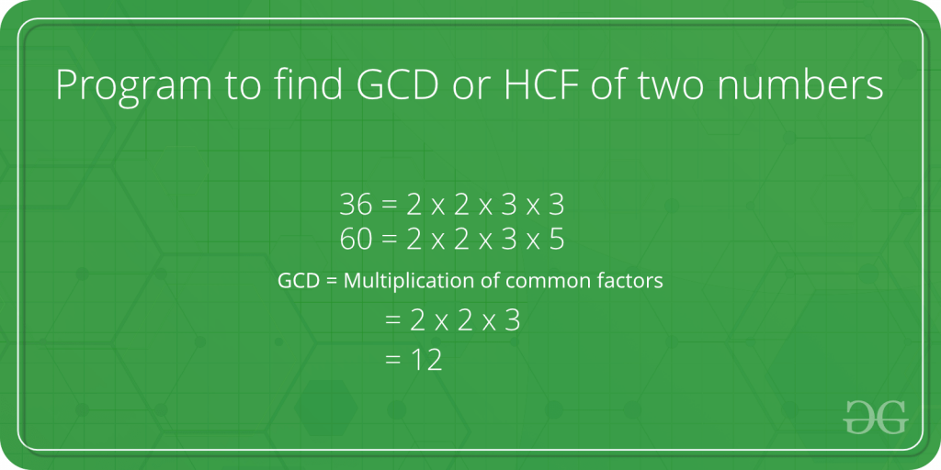
Greatest common divisor (GCD)
GCD (Greatest Common Divisor) or HCF (Highest Common Factor) of two numbers is the largest number that divides both of them.

Slide 59
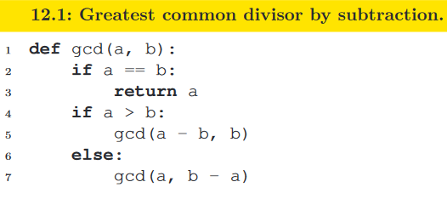
Euclidean algorithm by subtraction
The original version of Euclid’s algorithm is based on subtraction: we recursively subtract the smaller number from the larger
The number of steps can be linear, for e.g. gcd(x, 1), so the time complexity is O(n). This is the worst-case complexity, because the value x + y decreases with every step.

Slide 60
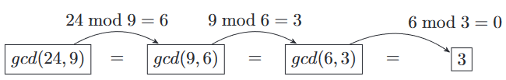
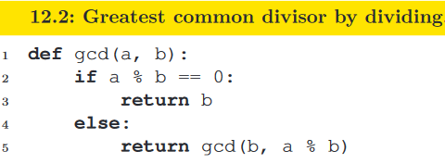
Euclidean algorithm by division
Understanding the algorithm and then go on to prove its correctness. For two given numbers a and b, such that a >=b
if b | a, then gcd(a, b) = b,
otherwise gcd(a, b) = gcd(b, a mod b).
The time complexity is logarithmic based on the sum of a and b — O(log(a + b)).

